Slide 1
Intro to Scikit-Learn (Machine Learning)
Lecture & Lab by Jordi Frank (GDI Teacher)

Slide 2
Overview
Intro to ML
What is ML? What are the use cases of ML?
When not to use ML?
Supervised vs. Semi-supervised vs. Unsupervised
ML Pipeline
How does the main “flow” look like for a typical ML project?
Intro to Scikit-Learn
Main tool in arsenal to apply ML methods in Python
Little bit of background on the history of Scikit-Learn
Introduction to MNIST dataset and virtual lab

Slide 3
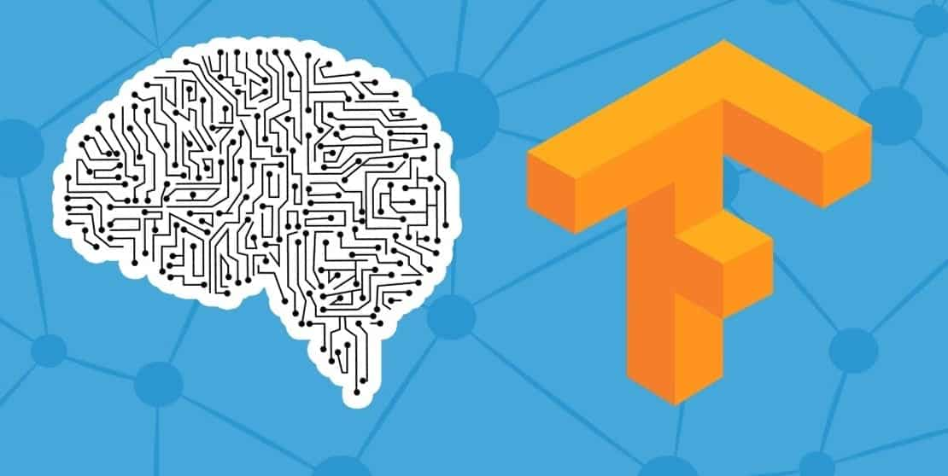

What is Machine Learning?
Probabilistic algorithms that learn from data in order to do do certain tasks. The algorithms’ ability to predict will improve over several iterations of learning.
Initially, ML Engineers program the model, but from that base model, the algorithms are able to learn to do a task “well” over time from the new, incoming data being fed to the model.
Deep Learning is similar, but involves neural networks larger, more complex architectures.

Slide 4
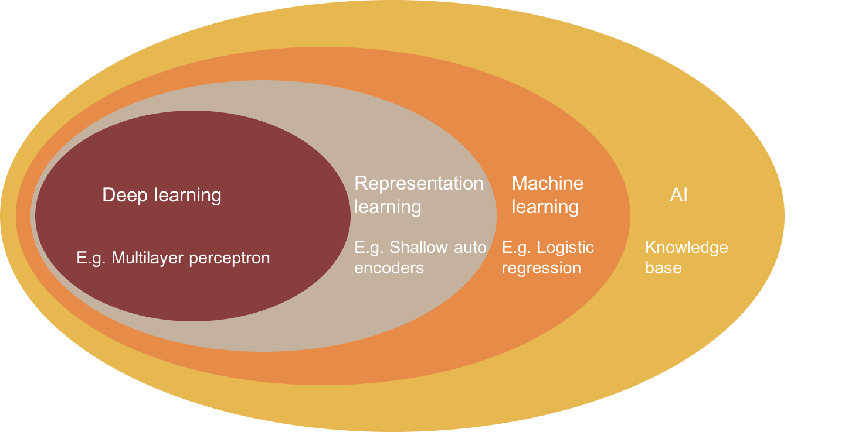

Slide 5


Use Cases
There are plenty of instances where ML can be applied to. For example:
Images Classify different stages of cancer based on a DB of images of those stages.
Numerical/Categorical Predicting house prices in a certain area based on income, race, education, etc.
Text Trying to tell whether a review for a restaurant is negative or positive based on certain keywords.

Slide 6

When Not To Use ML
When there is not enough sufficient data in order to build a model off of. (S/N: Can possibly be mitigated through some unsupervised learning techniques, but that depends on the quality of the data)
When you haven’t gone through more “simple”/”manual” heuristic strategies before applying ML (i.e. using time-series analysis vs. ML model)
When your team hasn’t discuss the problem statement, variables, and end goal(s) in much detail.

Slide 7
Types of Machine Learning
Supervised Learning
Uses completely labeled data as the target variable in order to be predicted or classified upon. (i.e. predicting images of food based on established classes associated with those images
Unsupervised Learning
Unlabeled data is involved in this type of learning, but it is used to detect certain patterns (i.e. buying patterns for a certain market, edges in a photo, etc.) that exists in the unlabeled data.

Slide 8
Types of Machine Learning (cont.)
Semi-supervised Learning
Uses partially labeled data in order to detect/classify certain patterns of the data (i.e. you can possibly build a classifier that has partially labeled food dataset to tell the difference between the labeled and unlabeled data).

Slide 9
(Data without or partial labels)
(Data with labels)
Input
Input
Supervised Learning
(Semi)/(Un)-supervised Learning
Retraining Process
Output
(Mapping)
Output
(Classes)

Slide 10

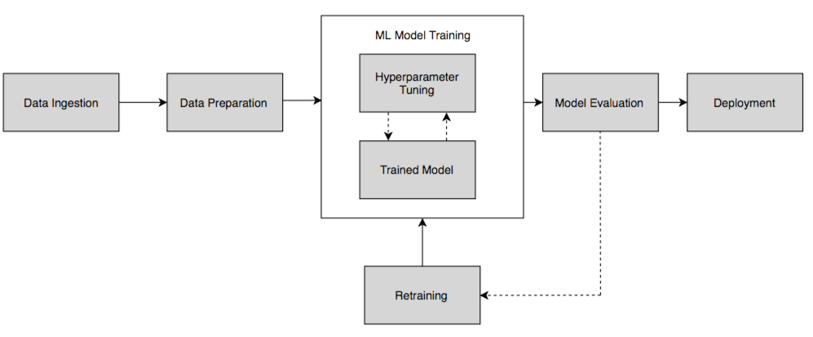
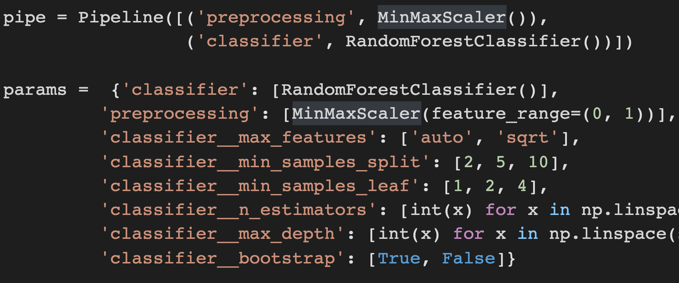
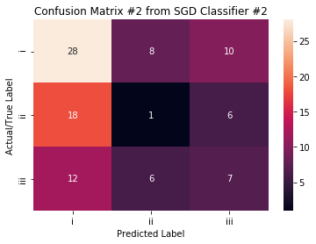


Machine Learning Pipeline

Slide 11
Intro to Scikit-Learn
(...for real this time!)

Slide 12

What is Scikit-Learn?
A Python library that contains a whole cornucopia of Machine Learning algorithms and is used in conjunction with NumPy, SciPy, and Pandas in order to enact the entire ML pipeline from data sequesturing to model deployment.
Was created 13 years ago as a Summer of Code project (by Google) by David Courneapeau and other developers who contributed to this project later on.

Slide 13
Types of Scikit-Learn Models
Binary Classifiers
Models that can handle a dataset with one target variable with a binary label (i.e. YES/NO). Examples: Logistic Regression, Ridge Classifier, Support Vector Machines (SVMs)
Multiclass Classifiers
Models that can handle a dataset with one target variable, but has multiple class outputs (i.e. different types of fruits, dogs, etc.). Examples: Random Forests, Decision Trees, SGD (Stochastic Gradient Descent) Classifiers, etc.

Slide 14
Types of Scikit-Learn Models (cont.)
Multilabel Classifiers
Models that can handle a certain number of labels (features) with binary classes (i.e. for feature 1, the labels can be YES/NO, feature 2, the labels can be positive or negative, etc.) Examples: KNeighbors Classifier (KNNs), Random Forests, MLP Classifiers
Multilabel Regressors
Similar to Multilabel Classifiers, but instead of having discrete/categorical/binary data as the classes, you have continuous numbers (i.e. housing prices, percentages, etc.) for the models to do predictions. Examples: Random Forests (Regressor), Tree Regressors

Slide 15
Types of Scikit-Learn Models (cont.)
Multilabel Multiclass Classifiers
Models that can handle both non-binary classes with a certain number of labels. It’s also as known as multi-task classification. (i.e. label 1 can be the types of fruits, where as label 2 can be the types colors). Examples: Random Forests, Decision Trees, KNNs

Slide 16
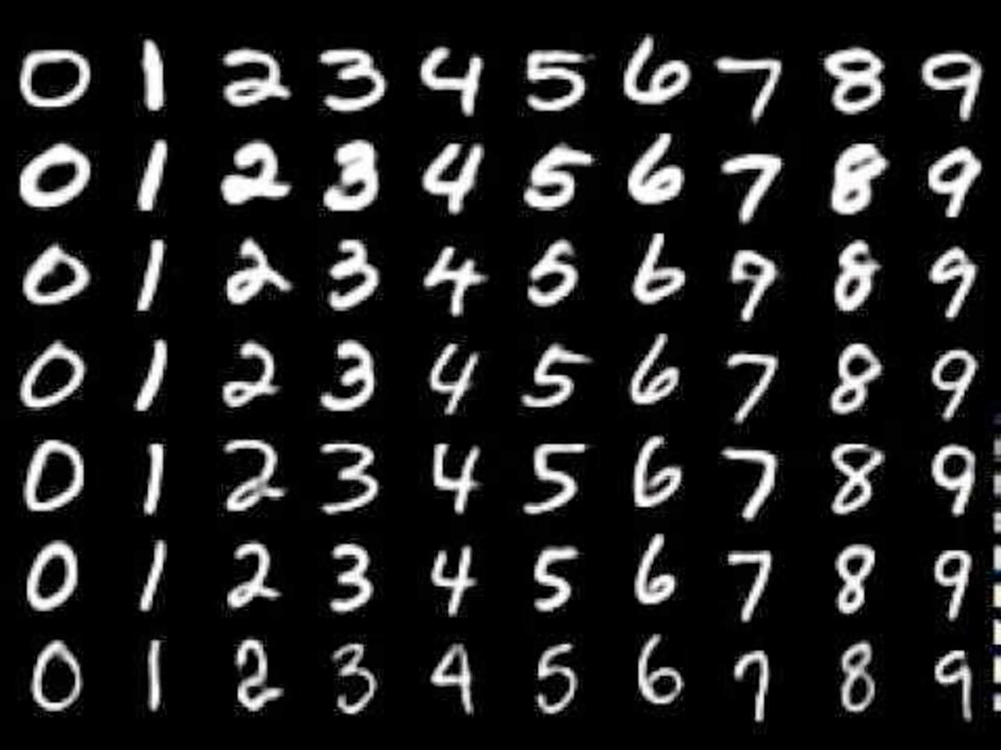
Meet the MNIST (Digit) Dataset
The MNIST dataset is one of the most popular datasets to do image classification tasks on. There are about ~70,000 images of digits from 0-9 with different image qualities, so it’s a great starter project to do image classification on.

Slide 17
Image Classification Focus (MNIST Dataset)

Slide 18
Image Classification Focus (cont.)
Model Selection & Training*
Logistic Regression
Stochastic Gradient Descent
Random Forest Classifier
Model Evaluation
Precision vs. Recall
ROC (Receiver Operating Characteristic)
ROC-AUC (Area Under the Curve)
Hyperparameter Tuning & Model Comparisons
Creating a pipeline and enacting a grid search to choose the best parameters for our selected model
*Will also be looking into cross-validation during training.

Slide 19
Q&A
(10 - 15 mins)

Slide 20
Now, let’s head onto the virtual lab. . .
(Github: https://bit.ly/3iTpI79)

